Slide 1
Modeling of System Behavior
Space-time diagram (STD)
Meaningful snapshots of a distributed system
Lattice of snapshots
Lattice as a partial order set
Lattice as all possible evolutions of system state
Lattice as a directed acyclic graph (DAG)
Lattice as an algebraic structure of snapshots
Relation between the STD and the lattice
Birkhoff’s representation theorem
Notes:
STD and lattice are two different characterization of the same distributed computation.
Distributed computation
As a Poset: <E,→>
As all possible linear extensions
As a directed acyclic graph STD 便于形象直观的理解
Lattice of snapshots of distributed computation
As a Poset:<Cuts,$≺$>
As all possible evolutions
As a directed acyclic graph
As an algebraic structure

Slide 2
Space-Time Diagram (STD)
An intuitive illustration of the distributed computation
s⁽¹⁾₀
e⁽¹⁾₁
s⁽¹⁾₁
e⁽¹⁾₂
s⁽¹⁾₂
e⁽¹⁾₃
s⁽¹⁾₃
e⁽¹⁾₄
s⁽¹⁾₄
P⁽¹⁾
P⁽²⁾
s⁽²⁾₀
e⁽²⁾₁
s⁽²⁾₁
e⁽²⁾₂
s⁽²⁾₂
e⁽²⁾₃
s⁽²⁾₃
e⁽²⁾₄
s⁽²⁾₄
time
Notes:
Distributed, asynchronous

Slide 3

Linear Extension
A total order of events [Schwarz@DC’94]
e⁽¹⁾₁
e⁽²⁾₁
e⁽²⁾₂
e⁽¹⁾₂
e⁽²⁾₃
e⁽¹⁾₃
e⁽¹⁾₄
e⁽²⁾₄
e⁽¹⁾₁
e⁽¹⁾₂
e⁽¹⁾₃
e⁽¹⁾₄
P⁽¹⁾
P⁽²⁾
e⁽²⁾₁
e⁽²⁾₂
e⁽²⁾₃
e⁽²⁾₄
time
e⁽¹⁾₁
e⁽²⁾₁
e⁽¹⁾₂
e⁽²⁾₂
e⁽¹⁾₃
e⁽²⁾₃
e⁽²⁾₄
e⁽¹⁾₄

Slide 4
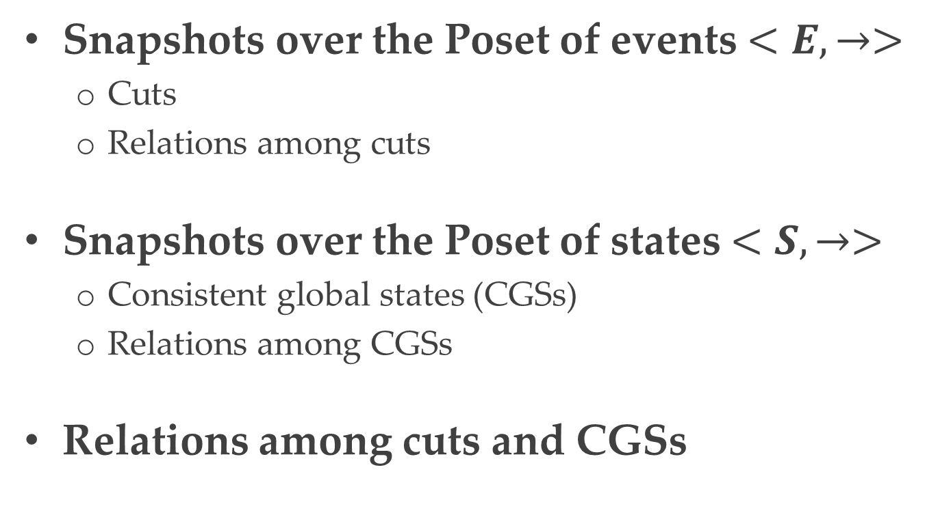
Meaningful Snapshots
Snapshots over the Poset of events $<E,→>$
Cuts
Relations among cuts
Snapshots over the Poset of states $<S,→>$
Consistent global states (CGSs)
Relations among CGSs
Relations among cuts and CGSs
Notes:
Here cut means consistent cut.

Slide 5



Cut
Snapshots over the trace of events
Distributed computation: $<E, →>$
Cut [Schwarz@DC’94]
e⁽¹⁾₁
e⁽¹⁾₂
e⁽¹⁾₃
e⁽¹⁾₄
P⁽¹⁾
P⁽²⁾
e⁽²⁾₁
e⁽²⁾₂
e⁽²⁾₃
e⁽²⁾₄
time

Slide 6








Relations among Cuts
The inclusion ($⊆$) partial relation
The inf ($⨅$) and sup ($⨆$) relation [Gratzer’03, Mittal@DC’05]
Interval of cuts [Chase@DC’98, Dumais@TPDS’02]
$$C_{1}$$
$$[C_{1},C_{2}]$$
$$C_{3}$$
$$C_{2}$$
e⁽¹⁾₁
e⁽¹⁾₂
e⁽¹⁾₃
e⁽¹⁾₄
P⁽¹⁾
P⁽²⁾
e⁽²⁾₁
e⁽²⁾₂
e⁽²⁾₃
e⁽²⁾₄
time
$$Inf(C_{2},C_{3})$$
$$sup(C_{2},C_{3})$$
$$C_{1}⊆C_{2}$$
Notes:
Partial relation
Two CGSs are not contained by each other. The graph representation is natural. On mathematical view, inf and sup are their meet and join, respectively.

Slide 7

Consistent Global State
Snapshots over the trace of local states
Distributed computation: $<S, →>$
Consistent global state (CGS) [Babaoglu@DS’93]
s⁽¹⁾₀
s⁽¹⁾₁
s⁽¹⁾₂
s⁽¹⁾₃
s⁽¹⁾₄
P⁽¹⁾
P⁽²⁾
s⁽²⁾₀
s⁽²⁾₁
s⁽²⁾₂
s⁽²⁾₃
s⁽²⁾₄
time
Notes:
CGS over the graph representation (space-time diagram) is the maximal anti-chain over the Poset.

Slide 8








Relations among CGSs
The precede ($≺$) partial relation
The lead-to ($⇝$) relation [Babaoglu@JPDC’95]
The inf ($⨅$)and sup ($⨆$) relation[Mattern@WPDA’89]
$$C_{1}⇝C_{3}$$
$$C_{1}≺C_{2}$$
s⁽¹⁾₀
s⁽¹⁾₁
s⁽¹⁾₂
s⁽¹⁾₃
s⁽¹⁾₄
P⁽¹⁾
$$Inf(C_{2},C_{3})$$
$$sup(C_{2},C_{3})$$
P⁽²⁾
s⁽²⁾₀
s⁽²⁾₁
s⁽²⁾₂
s⁽²⁾₃
s⁽²⁾₄
time
$$C_{3}$$
$$C_{1}$$
$$C_{2}$$
Notes:
Partial relation

Slide 9

Cuts and CGSs
$<C_{E}, ⊆>$ and $<C_{S}, ⇝>$ are isomorphic
$f:C_{E}→C_{S}$ is an isomorphism
$f$ is a bijection
$C_{1}⊆C_{2}$, iff $f(C_{1})⇝f(C_{2})$
[Babaoglu@DS’93, Gratzer’11]
s⁽¹⁾₀
e⁽¹⁾₁
s⁽¹⁾₁
e⁽¹⁾₂
s⁽¹⁾₂
e⁽¹⁾₃
s⁽¹⁾₃
e⁽¹⁾₄
s⁽¹⁾₄
P⁽¹⁾
P⁽²⁾
s⁽²⁾₀
e⁽²⁾₁
s⁽²⁾₁
e⁽²⁾₂
s⁽²⁾₂
e⁽²⁾₃
s⁽²⁾₃
e⁽²⁾₄
s⁽²⁾₄
time

Slide 10
Modeling of System Behavior
Space-time diagram (STD)
Meaningful snapshots of a distributed system
Lattice of snapshots
Lattice as a partial order set
Lattice as all possible evolutions of system state
Lattice as a directed acyclic graph
Lattice as an algebraic structure of snapshots
Relation between the STD and the lattice
Birkhoff’s representation theorem

Slide 11
















Lattice of Snapshots
The set of snapshots of a computation has the lattice structure [Mattern@WPDA’89]
The key notion in modeling global state evolution
P⁽²⁾
CGSs
$$C_{1}$$
$$C_{2}$$
$$C_{3}$$
$$\text{s}\text{(2)}\text{4}$$
The
precede
relation
s⁽¹⁾₀
s⁽¹⁾₁
s⁽¹⁾₂
s⁽¹⁾₃
s⁽¹⁾₄
$$C_{3}$$
P⁽¹⁾
$$\text{s}\text{(2)}\text{3}$$
$$C_{2}$$
$$\text{s}\text{(2)}\text{2}$$
$$C_{1}$$
P⁽²⁾
$$\text{s}\text{(2)}\text{1}$$
s⁽²⁾₀
s⁽²⁾₁
s⁽²⁾₂
s⁽²⁾₃
s⁽²⁾₄
time
$$\text{s}\text{(2)}\text{0}$$
$$\text{s}\text{(1)}\text{0}$$
$$\text{s}\text{(1)}\text{1}$$
$$\text{s}\text{(1)}\text{2}$$
$$\text{s}\text{(1)}\text{3}$$
$$\text{s}\text{(1)}\text{4}$$
P⁽¹⁾
Notes:
Focus on global snapshot, the snapshot is natural. Their relation is natural.

Slide 12















Lattice as a Poset
$L=<C_{S},⇝>$ is a lattice, iff
${∀C_{1},C}_{2}∈C_{S},inf\left({C_{1},C}_{2}\right)∈C_{S }⋀ sup⁡({C_{1},C}_{2})∈C_{S}$
[Gratzer’03]
P⁽²⁾
$$C_{1}$$
$$\text{s}\text{(2)}\text{4}$$
$$sup⁡({C_{1},C}_{2})$$
$$\text{s}\text{(2)}\text{3}$$
$$\text{s}\text{(2)}\text{2}$$
$$inf⁡({C_{1},C}_{2})$$
$$\text{s}\text{(2)}\text{1}$$
$$C_{2}$$
$$\text{s}\text{(2)}\text{0}$$
$$\text{s}\text{(1)}\text{0}$$
$$\text{s}\text{(1)}\text{1}$$
$$\text{s}\text{(1)}\text{2}$$
$$\text{s}\text{(1)}\text{3}$$
$$\text{s}\text{(1)}\text{4}$$
P⁽¹⁾

Slide 13


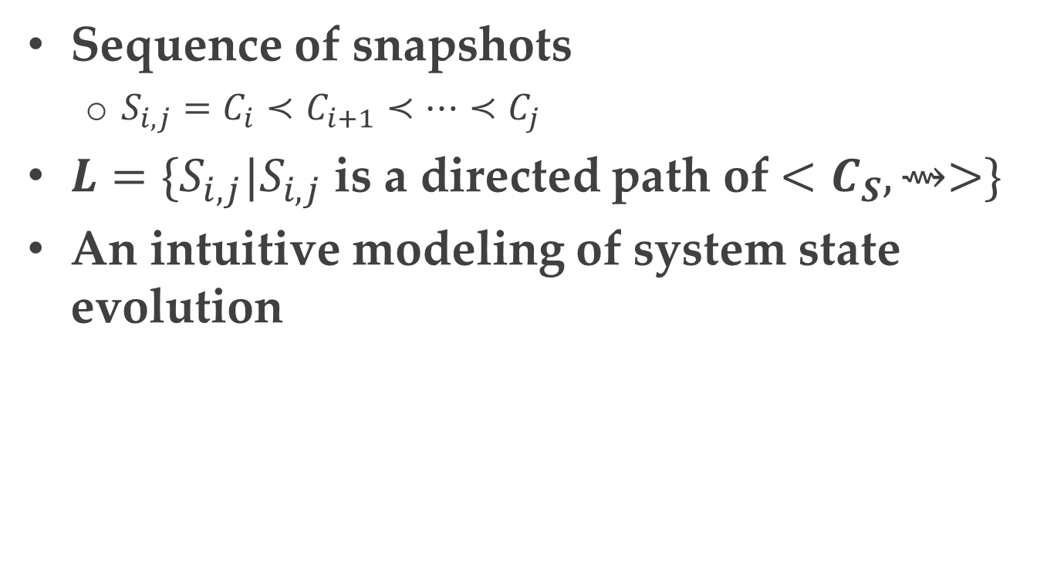








Lattice as All Possible Evolutions of System State
Sequence of snapshots
${S_{i,j}=C}_{i}≺C_{i+1}≺…≺C_{j}$
$L=\{S_{i,j}|S_{i,j}$ is a directed path of $<C_{S},⇝>\}$
An intuitive modeling of system state evolution
[Genon@FM’06]
P⁽²⁾
$$\text{s}\text{(2)}\text{4}$$
$$\text{s}\text{(2)}\text{3}$$
$$\text{s}\text{(2)}\text{2}$$
$$\text{s}\text{(2)}\text{1}$$
$$\text{s}\text{(2)}\text{0}$$
$$\text{s}\text{(1)}\text{0}$$
$$\text{s}\text{(1)}\text{1}$$
$$\text{s}\text{(1)}\text{2}$$
$$\text{s}\text{(1)}\text{3}$$
$$\text{s}\text{(1)}\text{4}$$
P⁽¹⁾
Notes:
Note: S_{i,j} is a directed path but not a total order of CGSs.

Slide 14











Lattice as a DAG
Poset $→$ Hasse diagram
Facilitating algorithms of lattice construction and traversal [Cooper@WPDD’91, Habib@TCS’96, Garg@PDCS’03, Alagar@TSE’01, Nourine@IPL’99, Hua@UIC’10]
P⁽²⁾
$$\text{s}\text{(2)}\text{4}$$
$$\text{s}\text{(2)}\text{3}$$
$$\text{s}\text{(2)}\text{2}$$
$$\text{s}\text{(2)}\text{1}$$
$$\text{s}\text{(2)}\text{0}$$
$$\text{s}\text{(1)}\text{0}$$
$$\text{s}\text{(1)}\text{1}$$
$$\text{s}\text{(1)}\text{2}$$
$$\text{s}\text{(1)}\text{3}$$
$$\text{s}\text{(1)}\text{4}$$
P⁽¹⁾
Notes:
Adopt data structures and algorithms of graph theory

Slide 15
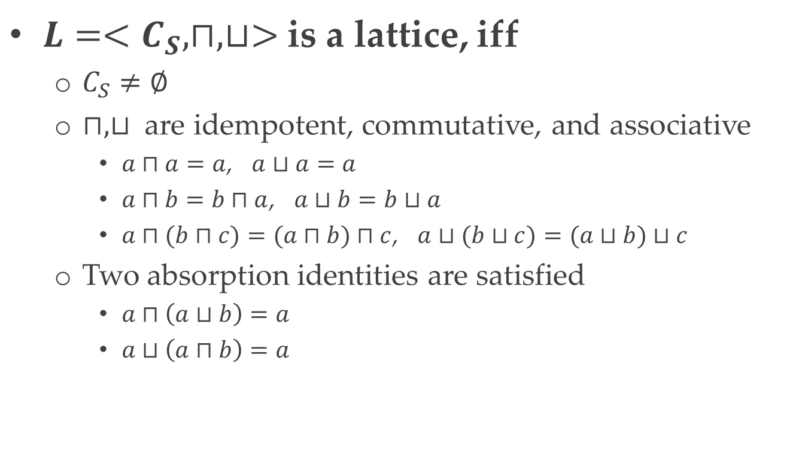
Lattice as an Algebraic Structure
$L=<C_{S}, ⊓,⊔>$ is a lattice, iff
$C_{S}≠∅$
$⊓,⊔$ are idempotent, commutative, and associative
$a⊓a=a$, $a⊔a=a$
$a⊓b=b⊓a$, $a⊔b=b⊔a$
$a⊓(b⊓c)=(a⊓b)⊓c$, $a⊔(b⊔c)=(a⊔b)⊔c$
Two absorption identities are satisfied
$a⊓\left(a⊔b\right)=a$
$a⊔\left(a⊓b\right)=a$
[Schwarz@DC’94, Gratzer’11]
Notes:
Idempotent幂等
Commutative交换
Associative结合
Absorptive吸收
Facilitate inference based on algebraic theories.

Slide 16
Modeling of System Behavior
Space-time diagram (STD)
Meaningful snapshots of a distributed system
Lattice of snapshots
Lattice as a partial order set
Lattice as all possible evolutions of system state
Lattice as a directed acyclic graph
Lattice as an algebraic structure of snapshots
Relation between the STD and the lattice
Birkhoff’s representation theorem

Slide 17











Distributive Lattice
$L=<C_{S}, ⊓,⊔>$is a distributive lattice [Gratzer’03]
$x⊓\left(y⊔z\right)=(x⊓y)⊔(x⊓z)$
$x⊔\left(y⊓z\right)=(x⊔y)⊓(x⊔z)$
Join/meet-irreducible elements [Garg@SIGACT’03, Gratzer’11]
P⁽²⁾
Join-irreducible
$$\text{s}\text{(2)}\text{4}$$
Meet-irreducible
$$\text{s}\text{(2)}\text{3}$$
$$\text{s}\text{(2)}\text{2}$$
$$\text{s}\text{(2)}\text{1}$$
$$\text{s}\text{(2)}\text{0}$$
$$\text{s}\text{(1)}\text{0}$$
$$\text{s}\text{(1)}\text{1}$$
$$\text{s}\text{(1)}\text{2}$$
$$\text{s}\text{(1)}\text{3}$$
$$\text{s}\text{(1)}\text{4}$$
P⁽¹⁾

Slide 18
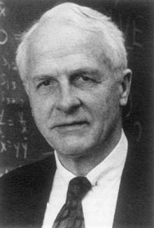














Birkhoff’s Representation Theorem
Isomorphism [Birkhoff@DMJ’37, Davey’90, Gratzer’11]
$L≅Down(JI(L))$
$P≅JI(Down(P))$
P⁽²⁾
$$L$$
$$Down(JI(L))$$
$$JI(L)$$
$$\text{s}\text{(2)}\text{4}$$
$$\text{s}\text{(2)}\text{3}$$
$$\text{s}\text{(2)}\text{2}$$
$$\text{s}\text{(2)}\text{1}$$
$$\text{s}\text{(2)}\text{0}$$
Garrett Birkhoff
$$\text{s}\text{(1)}\text{0}$$
$$\text{s}\text{(1)}\text{1}$$
$$\text{s}\text{(1)}\text{2}$$
$$\text{s}\text{(1)}\text{3}$$
$$\text{s}\text{(1)}\text{4}$$
P⁽¹⁾
[Birkhoff@DMJ’37] Rings of sets, Duke Mathematical Journal 3 (3): 443–454.

Slide 19













Birkhoff’s Representation Theorem
Isomorphism [Birkhoff@DMJ’37, Davey’90, Gratzer’11]
$L≅Down(JI(L))$
$P≅JI(Down(P))$
$$P$$
P⁽²⁾
$$Down(P)$$
$$JI(Down(P))$$
s⁽¹⁾₀
s⁽¹⁾₁
s⁽¹⁾₂
s⁽¹⁾₃
s⁽¹⁾₄
$$\text{s}\text{(2)}\text{4}$$
P⁽¹⁾
$$\text{s}\text{(2)}\text{3}$$
P⁽²⁾
$$\text{s}\text{(2)}\text{2}$$
P⁽²⁾
$$\text{s}\text{(2)}\text{1}$$
P⁽¹⁾
s⁽²⁾₀
s⁽²⁾₂
s⁽²⁾₃
s⁽²⁾₁
s⁽²⁾₄
time
$$\text{s}\text{(2)}\text{0}$$
$$\text{s}\text{(1)}\text{0}$$
$$\text{s}\text{(1)}\text{1}$$
$$\text{s}\text{(1)}\text{2}$$
$$\text{s}\text{(1)}\text{3}$$
$$\text{s}\text{(1)}\text{4}$$
P⁽¹⁾

